Slide 1
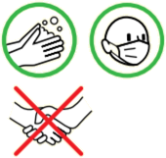
GENERAL SECURITY INSTRUCTIONS
« Objective 0 Accident / 0 Incident »
Speed limited to 10 km/h Traffic lines must be kept clear. Handling equipment is compliant and in good working order, operated by trained and authorized personnel. Unloading areas must be marked out or manned by a traffic warden. No smoking inside Respect waste sorting: Take your waste to the on-site waste collection center. | Co-activity: you’re not alone! Mark out your work areas. Electrical work is carried out off-line by authorized personnel. No storage outside the designated area. No storage or parking alongside buildings. Make sure you wear the appropriate PPE. Request a fire permit from the safety control center for hot-spot work. IN THE EVENT OF AN ACCIDENT or FIRE OUTBREAK CONTACT the Safety Control Center at: +33 (0)5.32.53.11.00 | Vigilance Working at height Work at height is carried out from safe platforms such as PIRL or rolling scaffolding. Reminder: Work on ladders or stepladders is prohibited. Wear a harness if necessary. Coronavirus Pandemic Continue to protect yourself and those around you with barrier gestures.
Anyone failing to comply with these rules may be excluded.

Slide 2
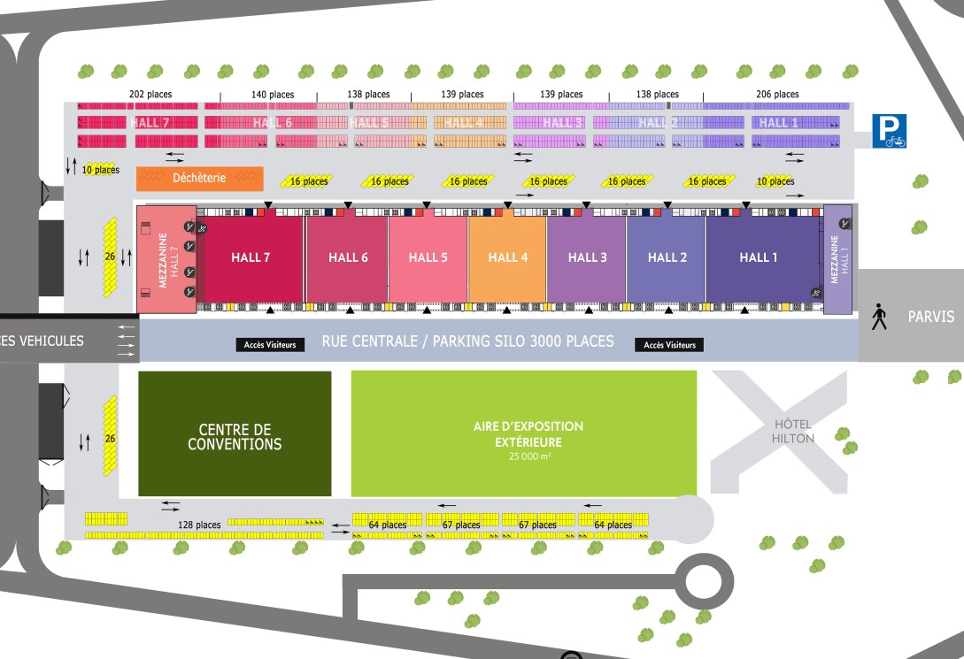
Zone Demi-tour
PC
Sécurité
Access to the Halls
Temporary parking area

